Slide 1
Milestone 4 - SupportPilot – AI Ticket Resolution Agent

Slide 2
Milestone 4 (Weeks 7–8) – Dashboard & Optimization
Develop support analytics dashboard.
Implement escalation workflows and monitoring.
Perform testing, optimization, and deployment.

Slide 3
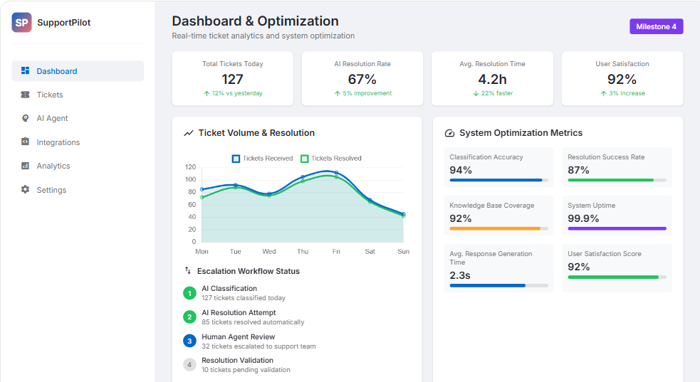

Slide 4
Week 7 — Dashboard & Escalation
Build a support analytics dashboard.
Track:
  Total tickets
  AI resolution rate
  Average resolution time
  Customer satisfaction
  Classification accuracy
  Resolution success rate
  Knowledge-base coverage
  System uptime
  Average AI response time
Implement automatic escalation.
Monitor tickets that require human intervention.

Slide 5
Week 8 — Testing, Optimization & Deployment
Test the AI classifier.
Measure precision, recall and accuracy.
Optimize response generation.
Test escalation rules.
Add logging and monitoring.
Deploy the dashboard.

Slide 6
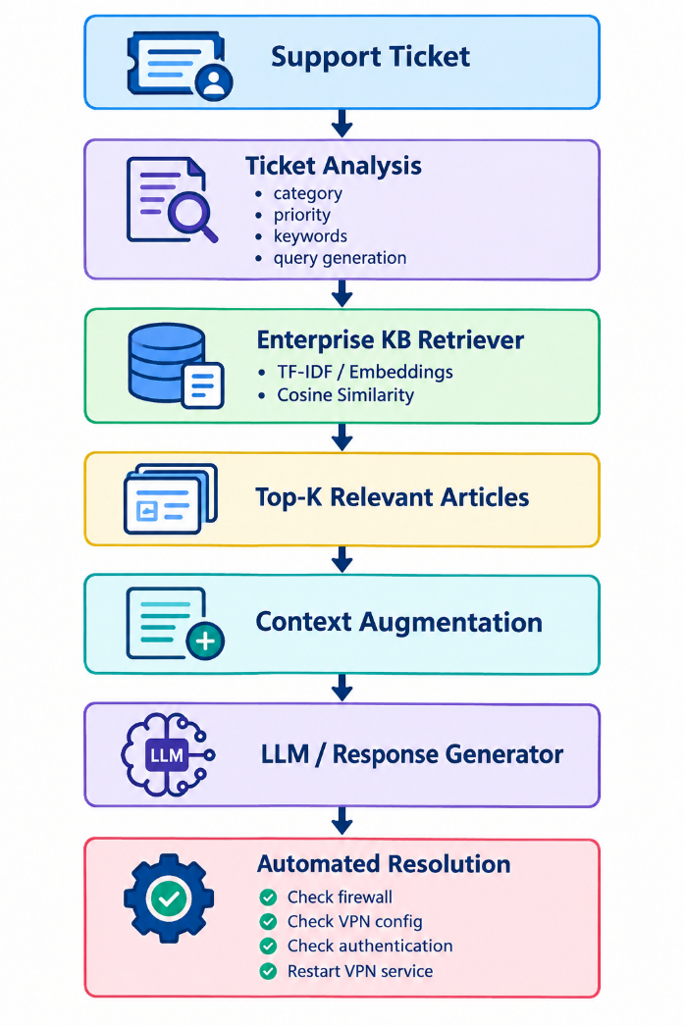
Overall Architecture

Slide 7
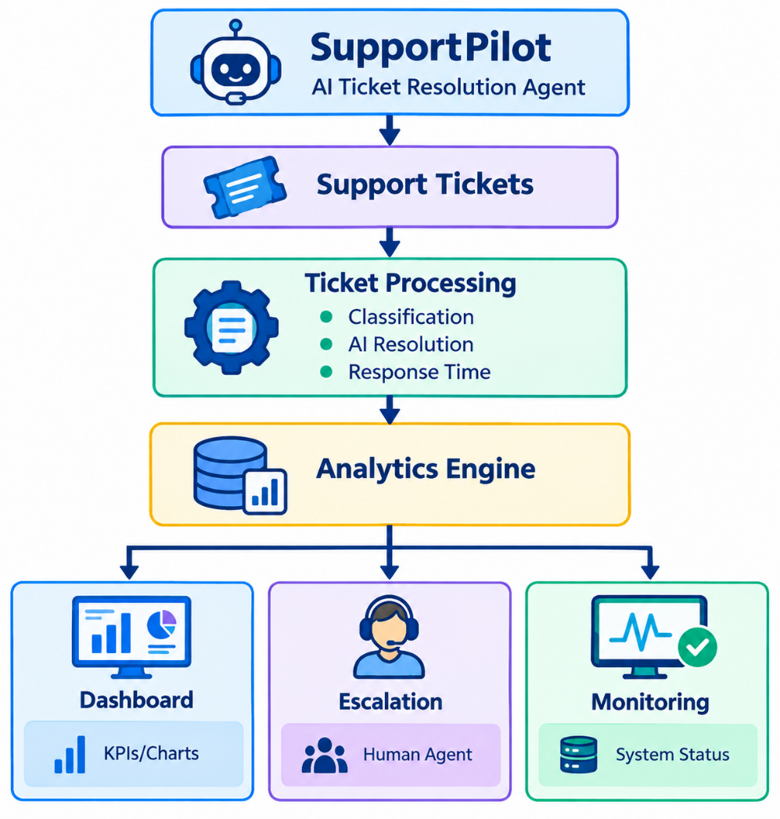
1. Dashboard architecture

Slide 8
2. Dashboard metrics
Metric | Meaning
Total Tickets | Total number of support tickets received
AI Resolution Rate | Percentage of tickets resolved automatically by AI
Average Resolution Time | Average time required to resolve a ticket
Customer Satisfaction | Average customer rating
Classification Accuracy | Percentage of correctly classified tickets
Resolution Success Rate | Percentage of tickets successfully resolved
Knowledge-Base Coverage | Percentage of tickets for which relevant KB information was found
System Uptime | Percentage of time SupportPilot is available
Average AI Response Time | Average time taken by AI to generate a response

Slide 9
Important formulas
AI Resolution Rate
AI Resolution Rate = (AI Resolved Tickets / Total Tickets) × 100
Resolution Success Rate
Resolution Success Rate = (Successfully Resolved Tickets / Total Tickets) × 100
Knowledge-Base Coverage
KB Coverage = (Tickets with Relevant KB Article / Total Tickets) × 100

Slide 10
3. Automatic escalation
SupportPilot should not attempt to resolve every ticket automatically.
A ticket can be escalated when:
IF
priority = "Critical"
OR
AI confidence < 0.70
OR
resolution_failed = True
OR
customer_requested_human = True
OR
repeated_attempts >= 3
THEN
Escalate to Human Agent
ELSE
Continue AI Resolution

Slide 11
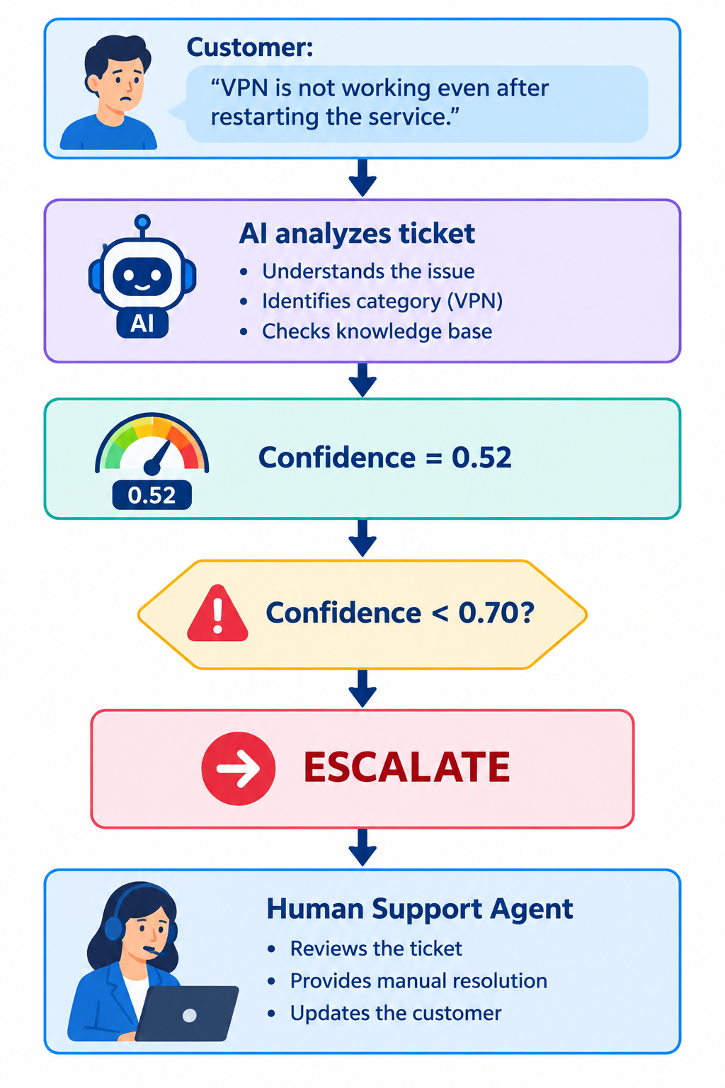
Example:

Slide 12
4. Python implementation
The following implementation uses Python + Pandas + Streamlit + Plotly.
Install the required packages:
pip install streamlit pandas plotly
Create a file called:
app.py

Slide 13
Complete app.py
import streamlit as st
import pandas as pd
import plotly.express as px
# --------------------------------------------------
# PAGE CONFIGURATION
# --------------------------------------------------
st.set_page_config(
page_title="SupportPilot Dashboard",
page_icon="🎫",
layout="wide"
)
st.title("🎫 SupportPilot – AI Ticket Resolution Agent")
st.subheader("Week 7: Dashboard & Automatic Escalation")

Slide 14
# --------------------------------------------------
# SAMPLE SUPPORT TICKET DATA
# --------------------------------------------------
data = {
"ticket_id": [
"T001", "T002", "T003", "T004", "T005",
"T006", "T007", "T008", "T009", "T010"
],
"category": [
"VPN", "Authentication", "Firewall", "VPN",
"Email", "VPN", "Authentication", "Firewall",
"VPN", "Email"
],
"priority": [
"High", "Medium", "Critical", "Low",
"Medium", "High", "Low", "Critical",
"Medium", "Low"
],

Slide 15
"ai_resolved": [
True, True, False, True, True,
False, True, False, True, True
],
"resolution_success": [
True, True, False, True, True,
False, True, False, True, True
],
"resolution_time": [
8, 5, 15, 6, 4,
25, 7, 18, 6, 5
],
"customer_rating": [
5, 4, 2, 5, 4,
2, 5, 3, 4, 5
],

Slide 16
"classification_correct": [
True, True, True, True, True,
False, True, True, True, True
],
"kb_found": [
True, True, False, True, True,
False, True, False, True, True
],
"ai_response_time": [
1.2, 0.8, 2.1, 0.9, 0.7,
2.5, 1.0, 2.2, 0.9, 0.8
],
"ai_confidence": [
0.94, 0.89, 0.45, 0.92, 0.95,
0.52, 0.91, 0.48, 0.88, 0.93
],

Slide 17
"customer_requested_human": [
False, False, True, False, False,
True, False, False, False, False
]
}
df = pd.DataFrame(data)

Slide 18
# --------------------------------------------------
# AUTOMATIC ESCALATION FUNCTION
# --------------------------------------------------
def check_escalation(row):
if row["priority"] == "Critical":
return "Escalate"
if row["ai_confidence"] < 0.70:
return "Escalate"
if not row["resolution_success"]:
return "Escalate"
if row["customer_requested_human"]:
return "Escalate"
return "AI Resolved"
df["status"] = df.apply(check_escalation, axis=1)

Slide 19
# --------------------------------------------------
# CALCULATE DASHBOARD METRICS
# --------------------------------------------------
total_tickets = len(df)
ai_resolved = df["ai_resolved"].sum()
ai_resolution_rate = (
ai_resolved / total_tickets
) * 100
average_resolution_time = (
df["resolution_time"].mean()
)
customer_satisfaction = (
df["customer_rating"].mean()
)
classification_accuracy = (
df["classification_correct"].mean()
) * 100

Slide 20
resolution_success_rate = (
df["resolution_success"].mean()
) * 100
kb_coverage = (
df["kb_found"].mean()
) * 100
average_ai_response_time = (
df["ai_response_time"].mean()
)
# Example system uptime
system_uptime = 99.7

Slide 21
# --------------------------------------------------
# KPI DASHBOARD
# --------------------------------------------------
st.markdown("## 📊 Support Analytics")
col1, col2, col3, col4 = st.columns(4)
col1.metric(
"Total Tickets",
total_tickets
)
col2.metric(
"AI Resolution Rate",
f"{ai_resolution_rate:.1f}%"
)
col3.metric(
"Avg Resolution Time",
f"{average_resolution_time:.1f} min"
)

Slide 22
col4.metric(
"Customer Satisfaction",
f"{customer_satisfaction:.1f}/5"
)
col5, col6, col7, col8 = st.columns(4)
col5.metric(
"Classification Accuracy",
f"{classification_accuracy:.1f}%"
)
col6.metric(
"Resolution Success",
f"{resolution_success_rate:.1f}%"
)
col7.metric(
"KB Coverage",
f"{kb_coverage:.1f}%"
)
col8.metric(
"System Uptime",
f"{system_uptime}%"
)

Slide 23
st.metric(
"Average AI Response Time",
f"{average_ai_response_time:.2f} sec"
)

Slide 24
# --------------------------------------------------
# CHART 1 – TICKET CATEGORY
# --------------------------------------------------
st.markdown("## 📈 Ticket Analysis")
category_count = (
df["category"]
.value_counts()
.reset_index()
)
category_count.columns = [
"Category",
"Tickets"
]
fig_category = px.bar(
category_count,
x="Category",
y="Tickets",
title="Tickets by Category"
)
st.plotly_chart(
fig_category,
use_container_width=True
)

Slide 25
# --------------------------------------------------
# CHART 2 – RESOLUTION STATUS
# --------------------------------------------------
status_count = (
df["status"]
.value_counts()
.reset_index()
)
status_count.columns = [
"Status",
"Tickets"
]
fig_status = px.pie(
status_count,
names="Status",
values="Tickets",
title="AI Resolution vs Escalation"
)
st.plotly_chart(
fig_status,
use_container_width=True
)

Slide 26
# --------------------------------------------------
# CHART 3 – PRIORITY
# --------------------------------------------------
priority_count = (
df["priority"]
.value_counts()
.reset_index()
)
priority_count.columns = [
"Priority",
"Tickets"
]
fig_priority = px.bar(
priority_count,
x="Priority",
y="Tickets",
title="Tickets by Priority"
)

Slide 27
st.plotly_chart(
fig_priority,
use_container_width=True
)
# --------------------------------------------------
# ESCALATION SECTION
# --------------------------------------------------
st.markdown("## 🚨 Automatic Escalation")
escalated_tickets = df[
df["status"] == "Escalate"
]
st.write(
f"Tickets requiring human intervention: "
f"**{len(escalated_tickets)}**"
)

Slide 28
st.dataframe(
escalated_tickets[
[
"ticket_id",
"category",
"priority",
"ai_confidence",
"resolution_success",
"customer_requested_human",
"status"
]
],
use_container_width=True
)

Slide 29
# --------------------------------------------------
# HUMAN INTERVENTION MONITOR
# --------------------------------------------------
st.markdown("## 👨‍💻 Human Intervention Monitor")
for _, ticket in escalated_tickets.iterrows():
st.warning(
f"Ticket {ticket['ticket_id']} requires "
f"human support | "
f"Priority: {ticket['priority']} | "
f"AI Confidence: {ticket['ai_confidence']:.2f}"
)

Slide 30
# --------------------------------------------------
# FOOTER
# --------------------------------------------------
st.markdown("---")
st.success(
"SupportPilot monitoring is active."
)

Slide 31
5. Run the application
Open Command Prompt/Terminal in the project folder:
streamlit run app.py
The dashboard will open in your browser.

Slide 32
+------------------------------------------------------+
| SupportPilot – AI Ticket Resolution Agent |
+------------------------------------------------------+
Total AI Resolution Avg Time Customer
Tickets Rate Resolution Satisfaction
10 70% 9.9 min 3.9/5
Classification Resolution KB Coverage Uptime
Accuracy Success
90% 70% 70% 99.7%
Ticket Analysis
┌───────────────────┐
│ VPN █████ │
│ Firewall ███ │
│ Email ██ │
└───────────────────┘

Slide 33
🚨 Automatic Escalation
Ticket T003 → Human Agent
Ticket T006 → Human Agent
Ticket T008 → Human Agent

Slide 34
How Week 7 works in SupportPilot
Example
A VPN ticket arrives:
Ticket: "VPN connection is failing after authentication."
SupportPilot performs:
Category → VPN
Priority → High
KB Retrieval → VPN troubleshooting article
AI Confidence → 0.92
Resolution → Check VPN configuration
Result → Successfully resolved
Because confidence is high and the resolution succeeds:
AI → Resolve automatically

Slide 35
For another ticket:
AI Confidence = 0.52
Resolution = Failed
The escalation module performs:
0.52 < 0.70
↓
Escalate
↓
Human Support Agent

Slide 36
